Slide 1
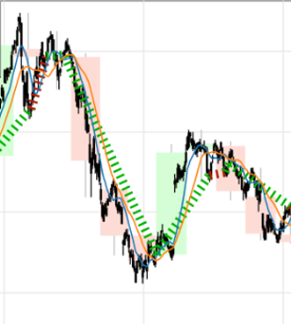
Backtesting using SMA(Simple Moving Average) cross over strategy
Sell
Buy

Slide 2
Synopsis
Code
from backtesting import Backtest, Strategy
from backtesting.lib import crossover
from backtesting.test import SMA, GOOG
class SmaCross(Strategy):
n1 = 10
n2 = 20
def init(self):
close = self.data.Close
self.sma1 = self.I(SMA, close, self.n1)
self.sma2 = self.I(SMA, close, self.n2)
def next(self):
if crossover(self.sma1, self.sma2):
self.buy()
elif crossover(self.sma2, self.sma1):
self.sell()
bt = Backtest(GOOG, SmaCross,
cash=10000, commission=.002,
exclusive_orders=True)
output = bt.run()
bt.plot()
The example shows a simple, unoptimized moving average cross-over strategy. It's a common introductory strategy and a pretty decent strategy overall, provided the market isn’t going sideways.
We begin with 10,000 units of currency in cash, realistic 0.2% broker commission, and we trade through 9 years worth of Alphabet Inc. stock.
Whenever the fast, 10-period simple moving average of closing prices crosses above the slower, 20-period moving average, we go long, buying as many stocks as we can afford. When it crosses below, we close our long position and go short.

Slide 3
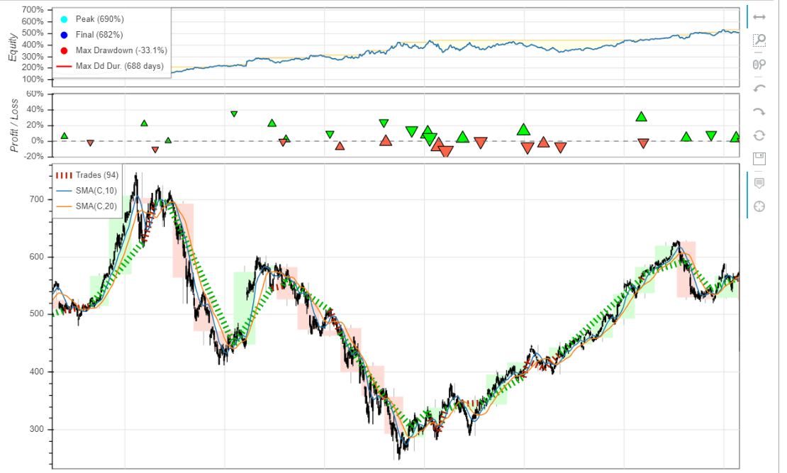

Slide 4
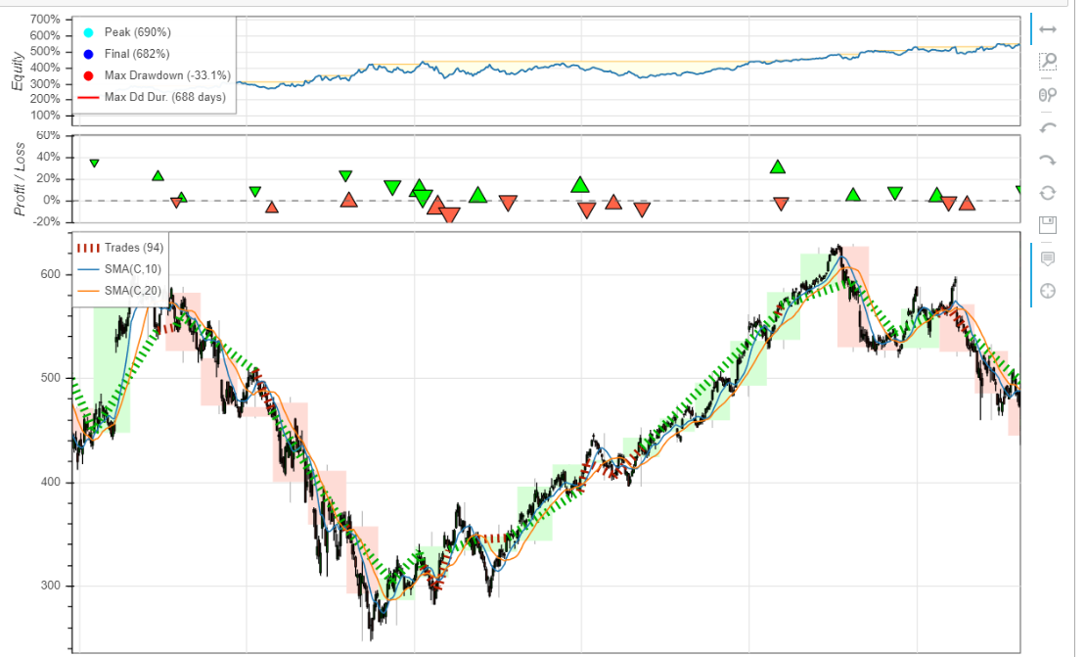

Slide 5
